Slide 1

LOGIC Circuits

Slide 2

HAPPY NEW YEAR!

Slide 3
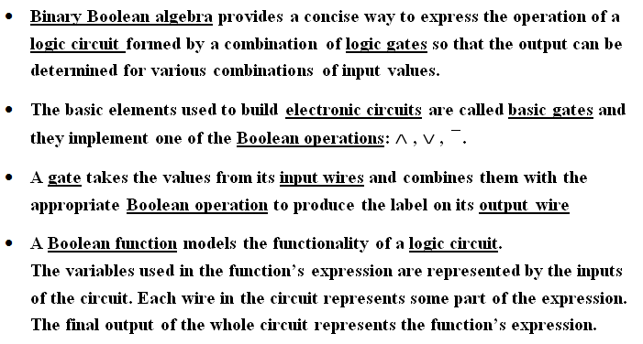
Logic Circuits

Slide 4
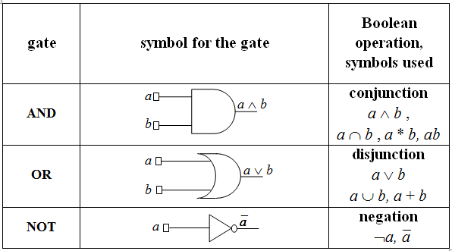
Basic gates – IEEE standards

Slide 5
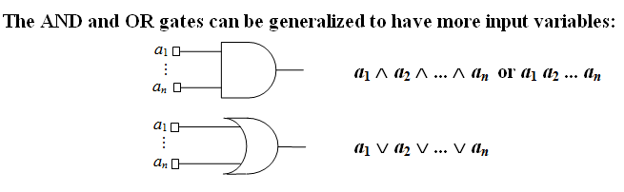
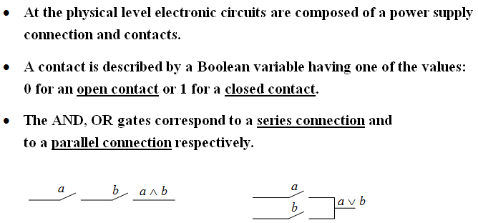

Slide 6
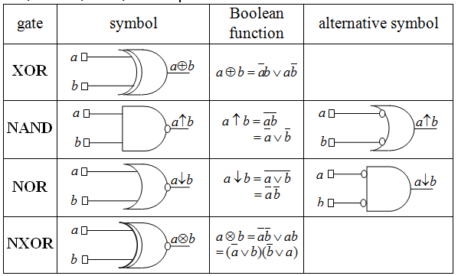
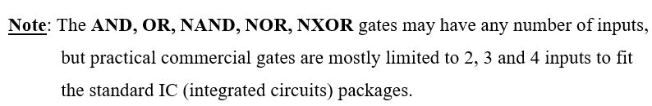
Derived gates: XOR, NAND, NOR, NXOR

Slide 7
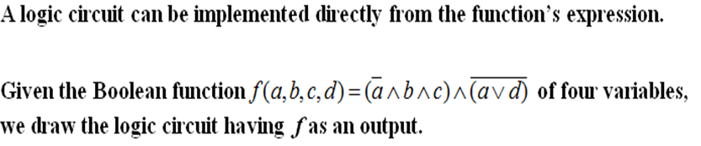
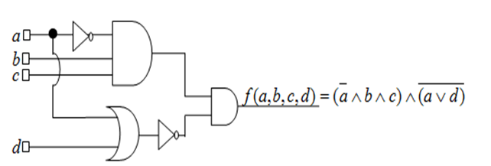
Example 1

Slide 8
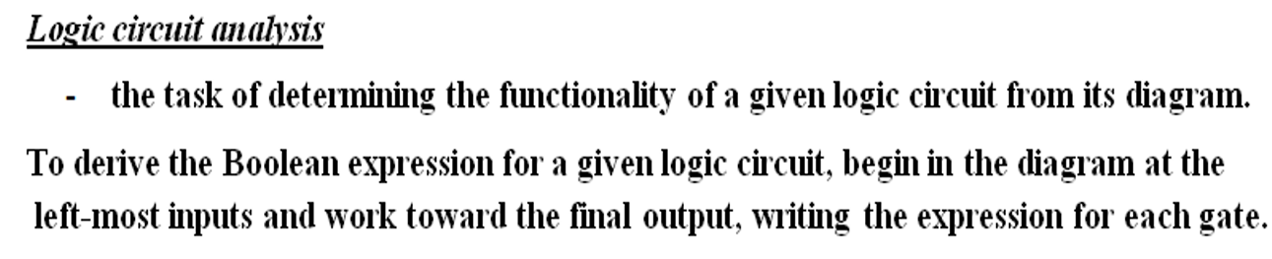
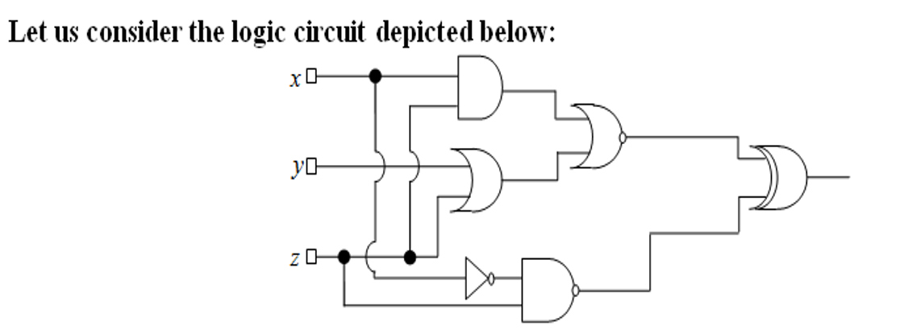




Example 2

Slide 9

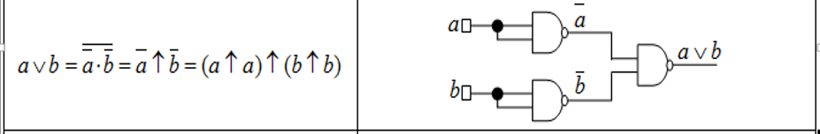
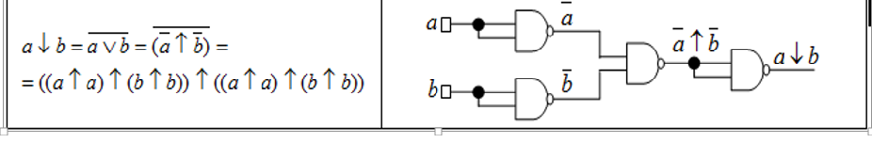
Example 3. NAND is a universal gate -it can be used to produce all the other gates

Slide 10
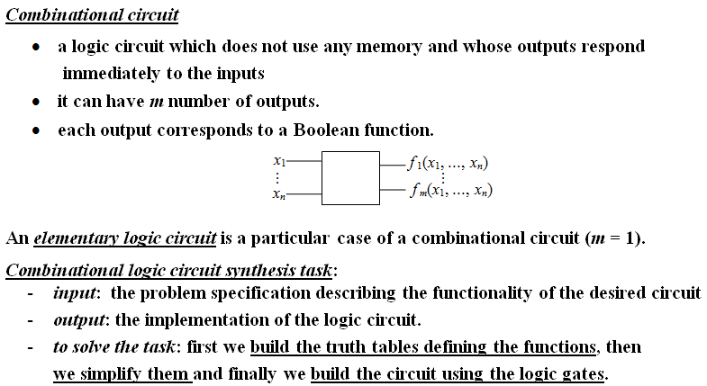
Combinational circuits

Slide 11
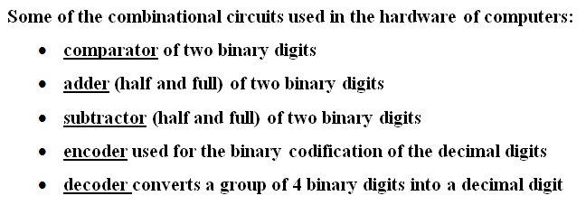
Examples of useful combinational circuits

Slide 12
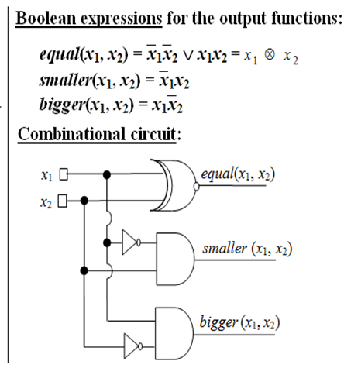
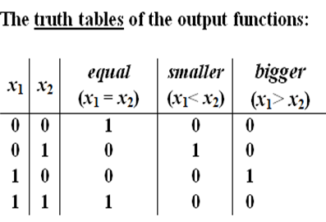
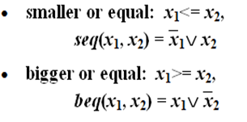
Example 4

Slide 13
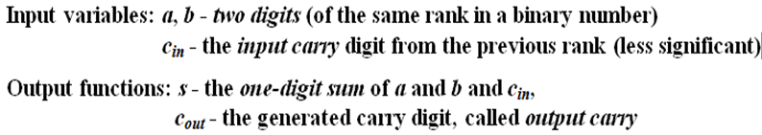
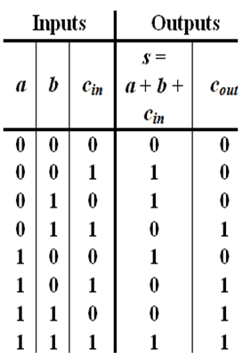
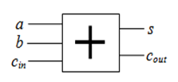
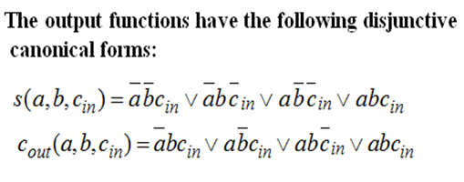
Example 5. Full Adder

Slide 14
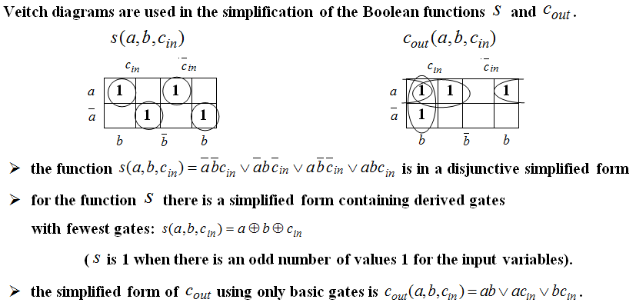
Example 5. Full Adder (contd.)

Slide 15
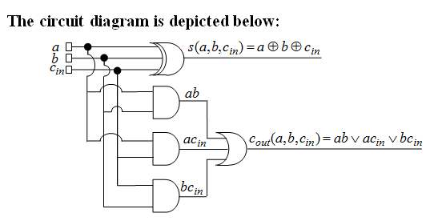
Example 5. Full Adder (contd.)

Slide 16
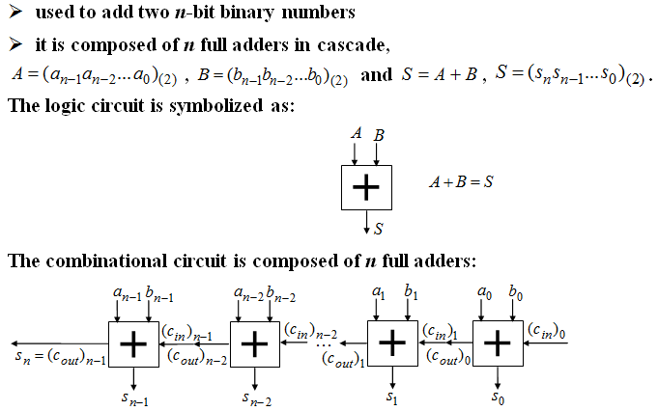
Example 6. n - bits adder

Slide 17
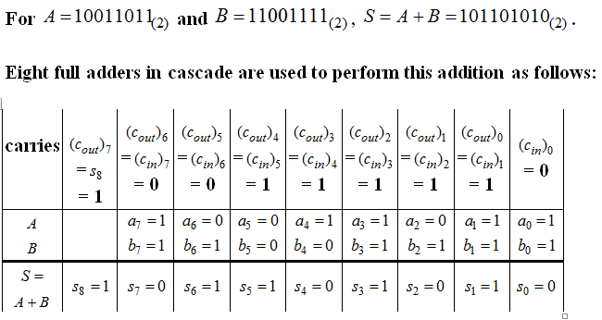
Example 6. n – bits adder (contd.)

Slide 18
Fun with logic circuits
Domino computer:
https://www.youtube.com/watch?v=w6E7aQnA4Ws
Marble adding machine
https://www.youtube.com/watch?v=GcDshWmhF4A
Water computer:
https://www.youtube.com/watch?v=IxXaizglscw
Logic gates using Gears, Marbles & Dominoes:
https://www.youtube.com/watch?v=kQeDnFUNW-Q
A Computer That Runs on Marbles:
https://www.youtube.com/watch?v=8BOvLL8ok8I

Slide 19
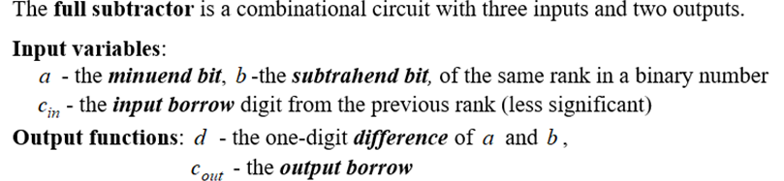
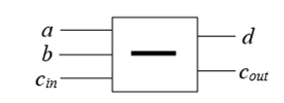
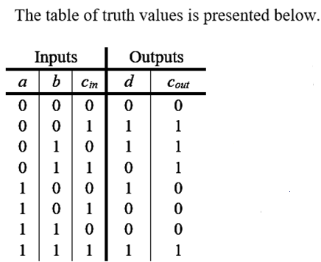
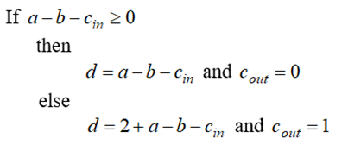
Example 7. Full Subtractor

Slide 20
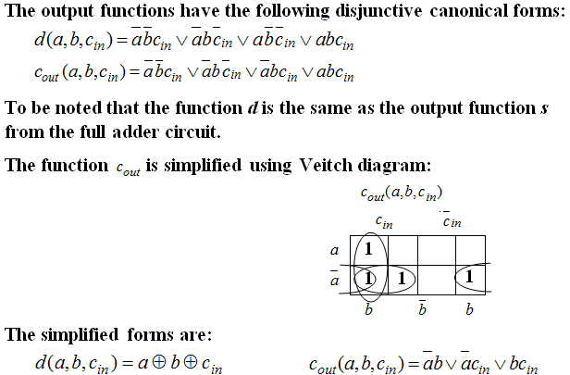
Example 7. Full Subtractor (contd.)

Slide 21
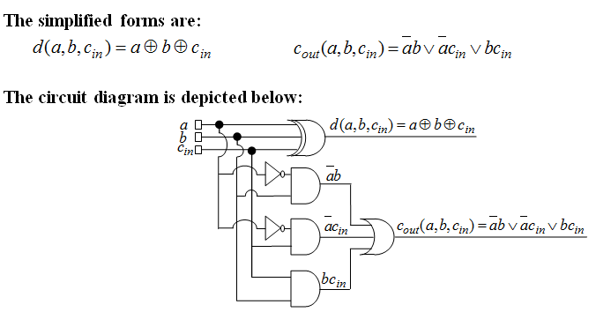
Example 7. Full Subtractor (contd.)

Slide 22
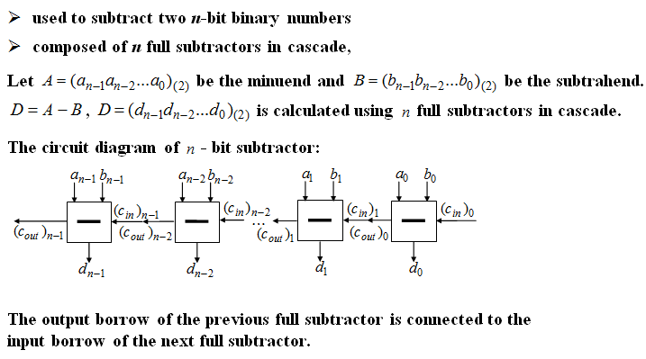
Example 8. n - bits subtractor

Slide 23
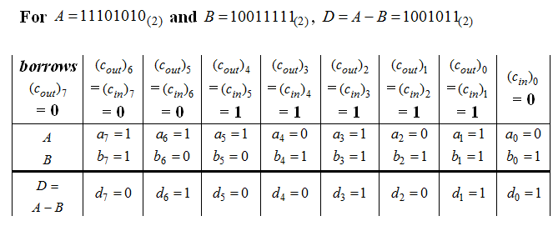
Example 8. n – bits subtractor (contd.)

Slide 24
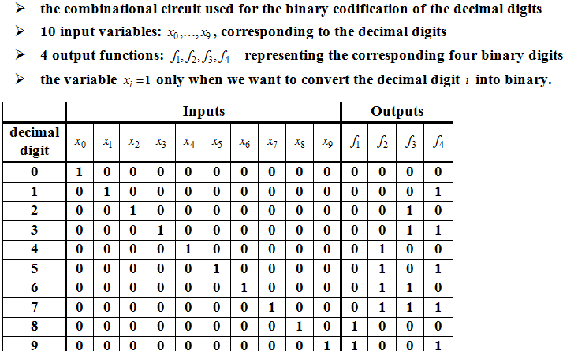
Example 9. Encoder

Slide 25
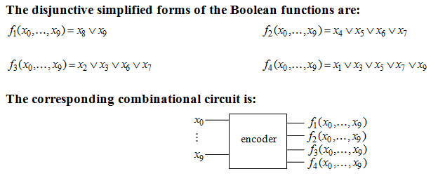
Example 9. Encoder (contd.)

Slide 26
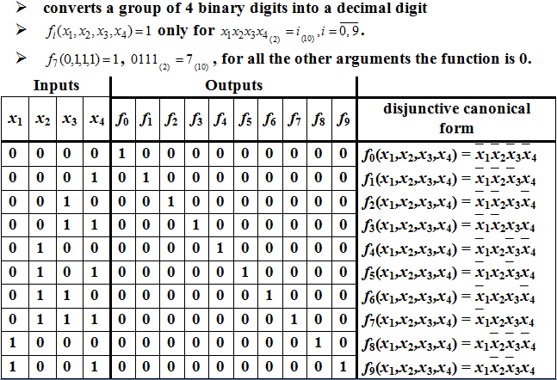
Example 10. Decoder

Slide 27
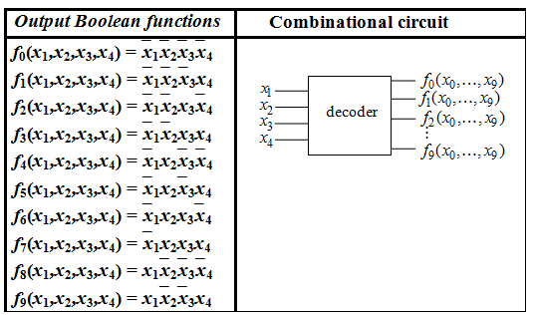
Example 10. Decoder (contd.)

Slide 28
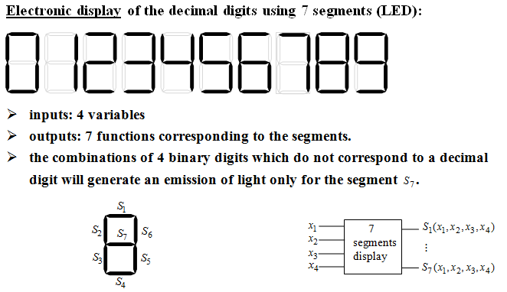
Example 11. 7 segments Circuit

Slide 29
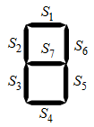
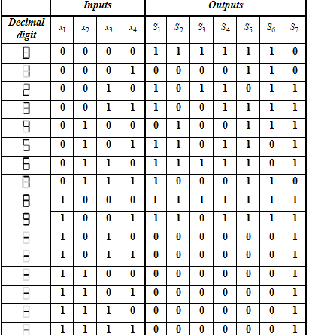
Example 11. 7 segments Circuit

Slide 30
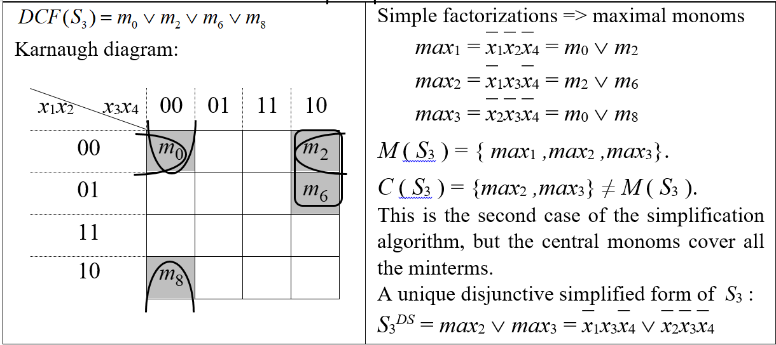
Example 12. Implement the Simplified Logic Circuit for S₃ using only NAND gates

Slide 31
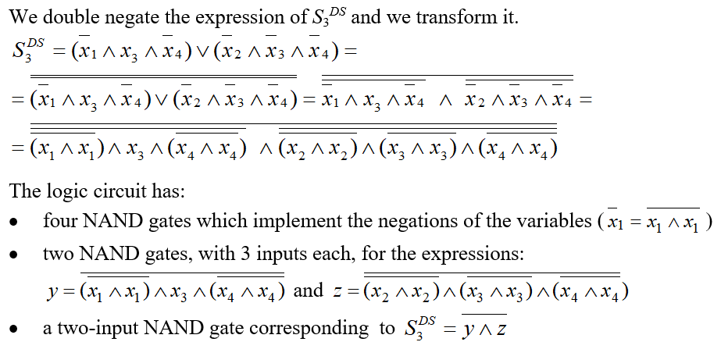
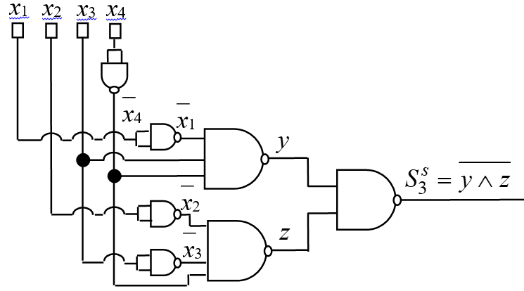
Example 12(contd.)

Slide 32
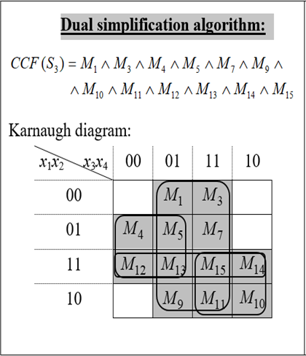
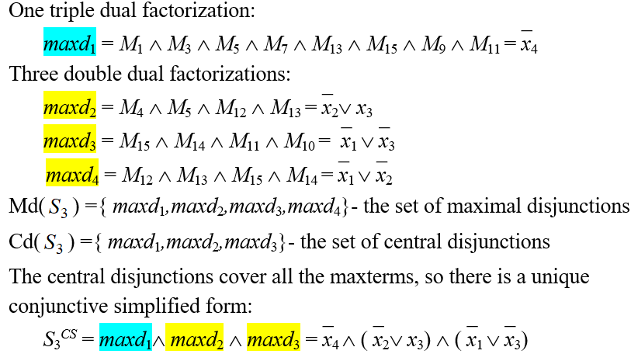
Example 13. Implement the Logic Circuit for S₃ using only NOR gates

Slide 33
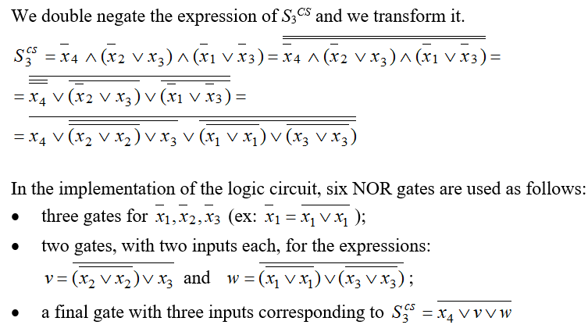
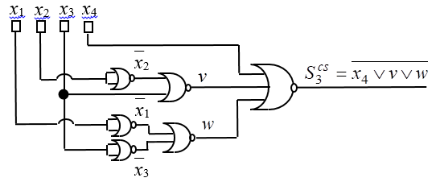
Example 13(contd.)

Slide 34
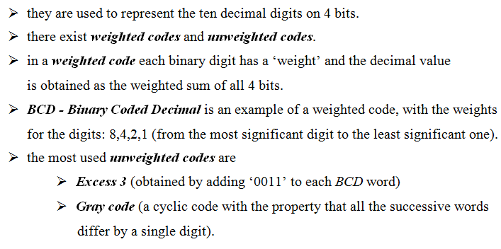
Binary codes

Slide 35
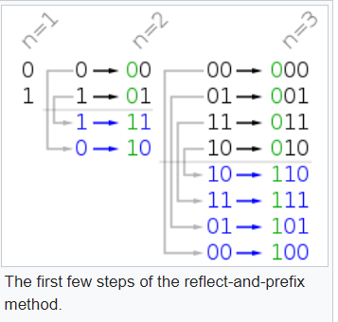
Gray Codes on n bits
The binary-reflected Gray code list for n bits can be generated recursively from the list for n − 1 bits by reflecting the list (i.e. listing the entries in reverse order), prefixing the entries in the original list with a binary 0, prefixing the entries in the reflected list with a binary 1.
Gray Codes are now widely used in digital communications, such as digital terrestrial television and some cable television systems, to aid in error correction and improve the signal’s overall quality.

Slide 36
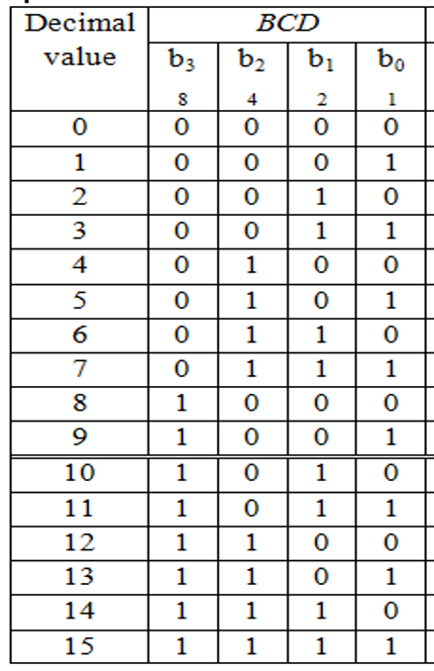

Binary codes (contd.)

Slide 37


Example 14.

